Slide 1
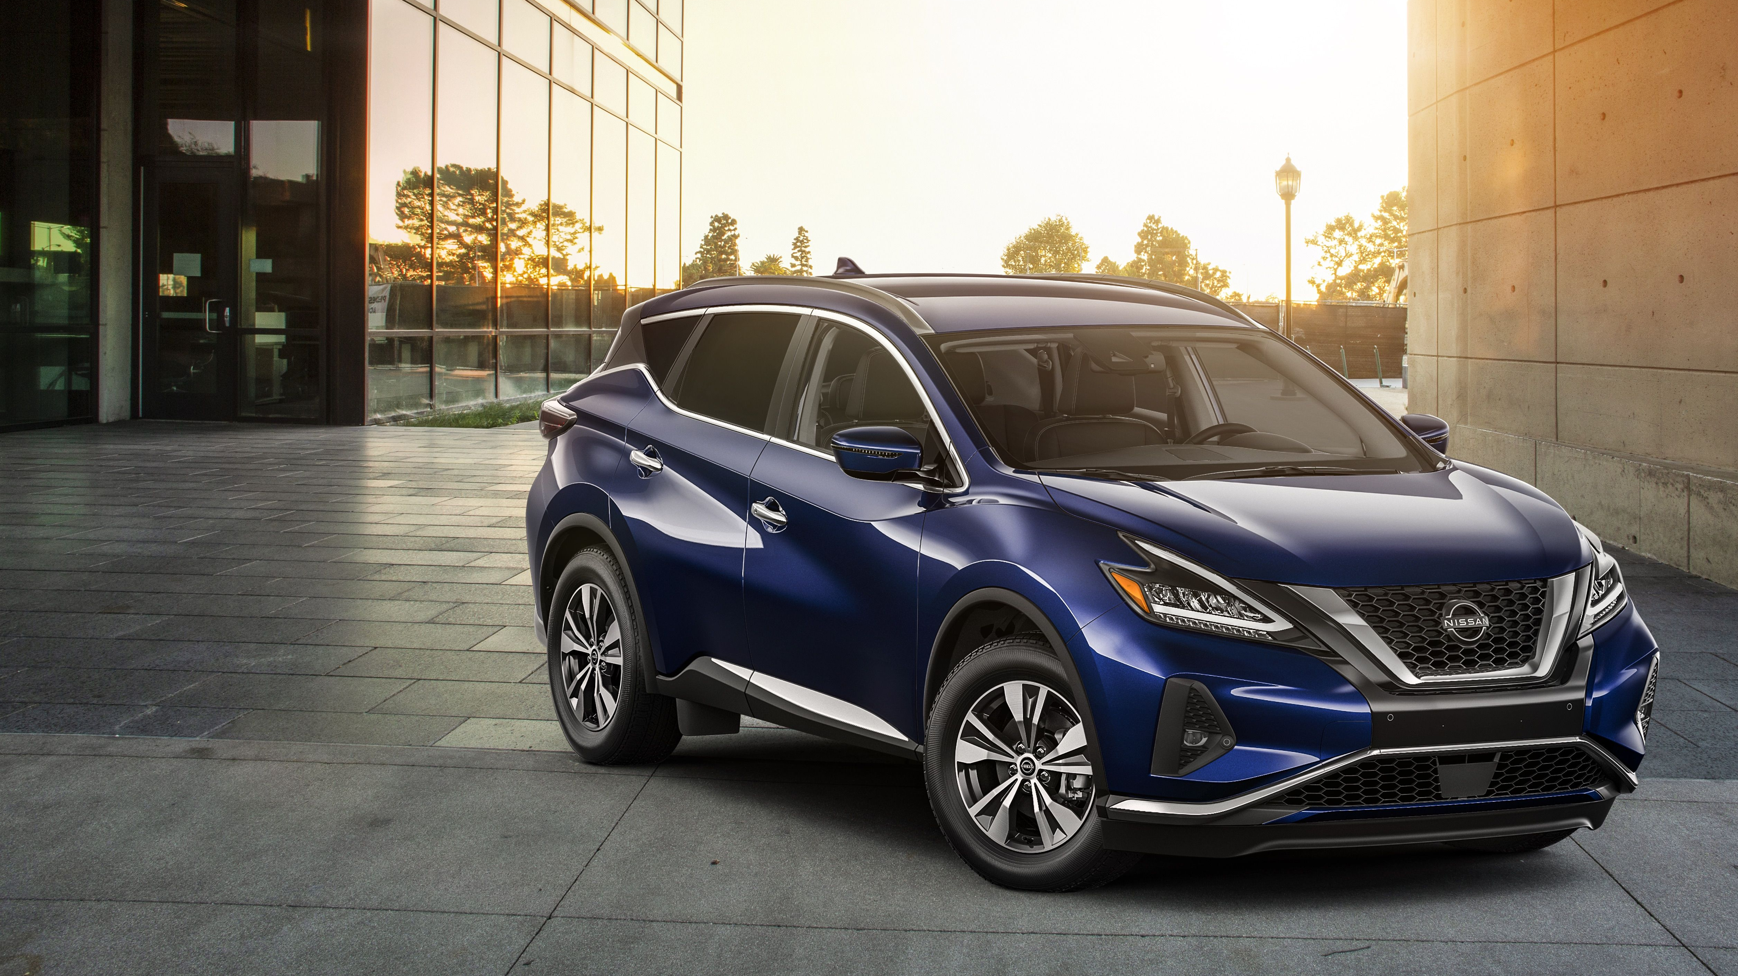
Nissan
Predicting MSRP and
Identifying Factors Impacting Price
Roma Chitale | Vamshi Gadepally | Daisuke Yagyu
Faculty Advisor: Anil Chaturvedi
University of Chicago MScA, August 2023
1

Slide 2




Team Members
Roma Chitale
Vamshi Gadepally
Daisuke Yagyu
Advisor:
Anil Chaturvedi, PhD
2

Slide 3

Agenda
Project Purpose & Opportunity
Data Sources & Exploratory Data Analysis
Feature Engineering
Modeling Workflow
Findings
Future Work
3

Slide 4

Project Purpose
&
Opportunity
4

Slide 5
Setting the Right MSRP is Critical to Nissan’s Success
Nissan changed its strategy in 2017 to prioritize sales volume over profit
Decreased brand value and caused sales to decline
Sales and profits have been declining over the years, with 2022 having the worst sales in a decade
Too High
Car too expensive; alienates buyers
Decreases sales
MSRP (Price)
Too Low
Diminishes brand value; decreases sales
Impacts profit margins
5

Slide 6
Determining MSRP is a Complicated Process
MSRP assumptions must be made 2-3 years before a vehicle hits the market
Nissan currently uses a linear regression of historical price to forecast future price
Existing methodology does not consider macroeconomic factors, vehicle specifications, and customer reviews
Existing Pricing Methodology
MSRP
Forecast
2018
2019
2020
2021
2022
2023
2025
6

Slide 7
Nissan’s Pricing Methodology Can be Improved Using Data Science
An accurate and comprehensive MSRP forecasting method can allow Nissan to optimize sales volume and profitability.
This can be achieved using:
MRSP Prediction Model with feature importance
Generalized Linear Model
7

Slide 8
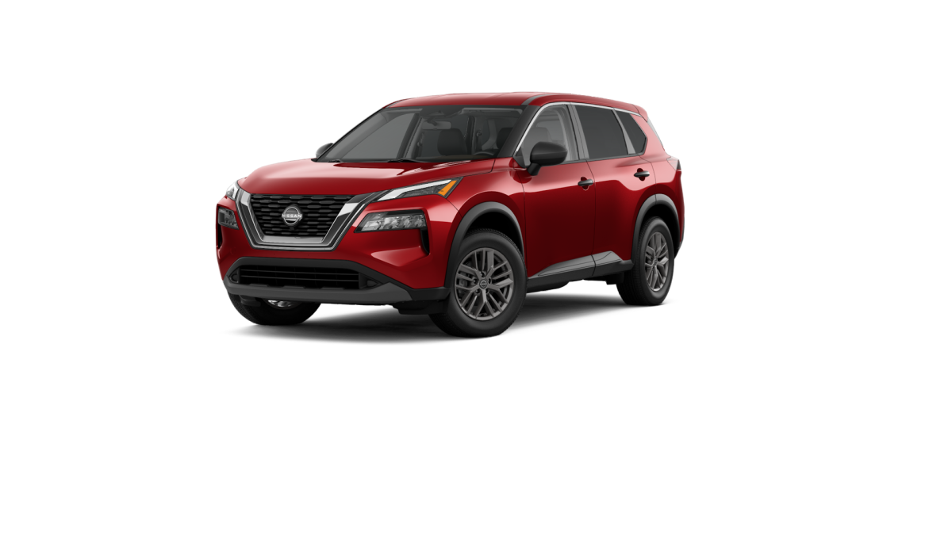
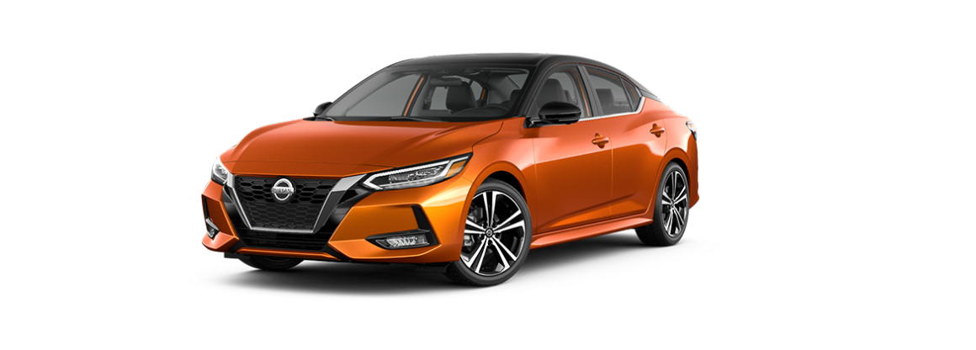
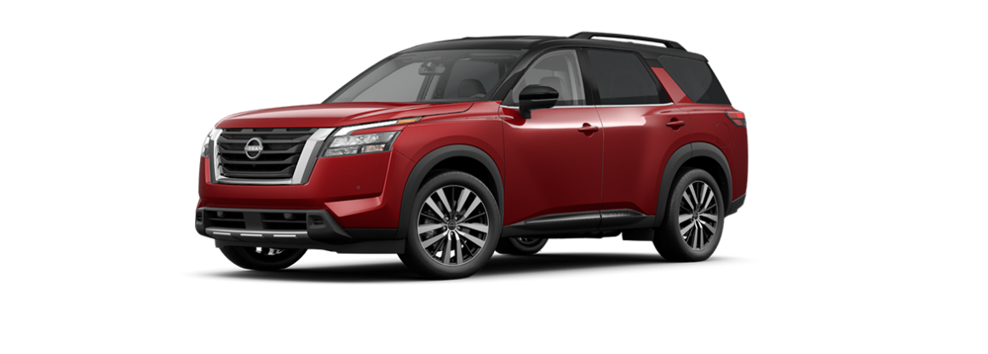
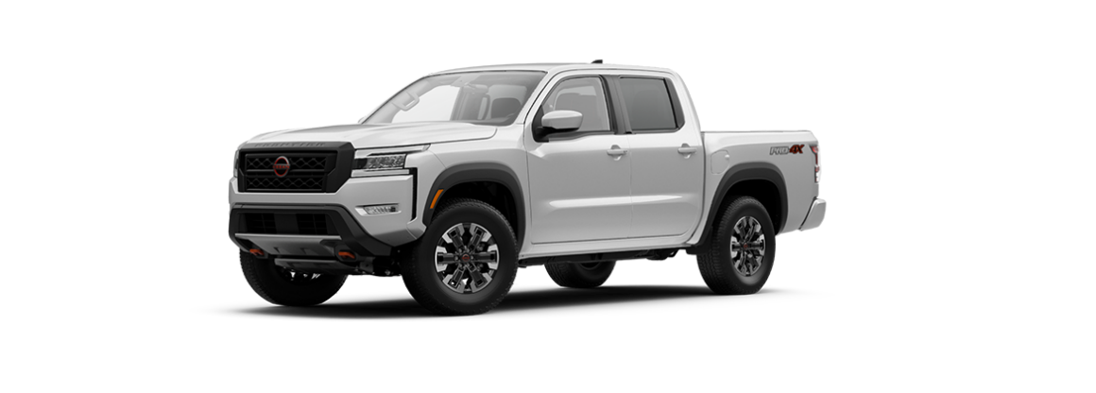
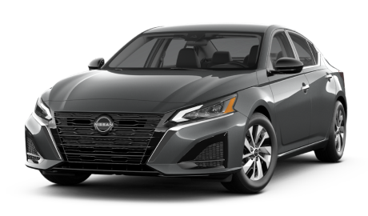
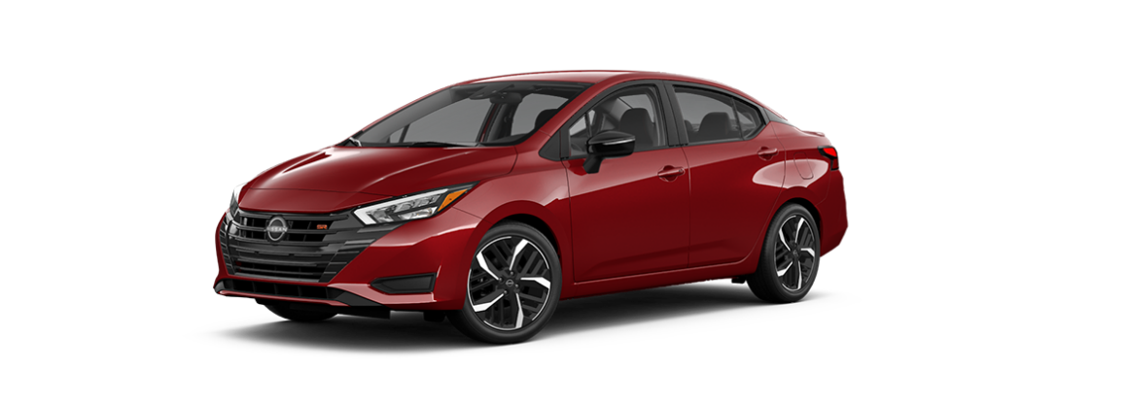
Using the New MSRP Prediction Model Could Have Led to An Additional $168M in Revenue
Revenue Opportunity
Low price Small size: $154M
Mid price Mid size: $14M
Scope: All new vehicles 2017~2022
8

Slide 9
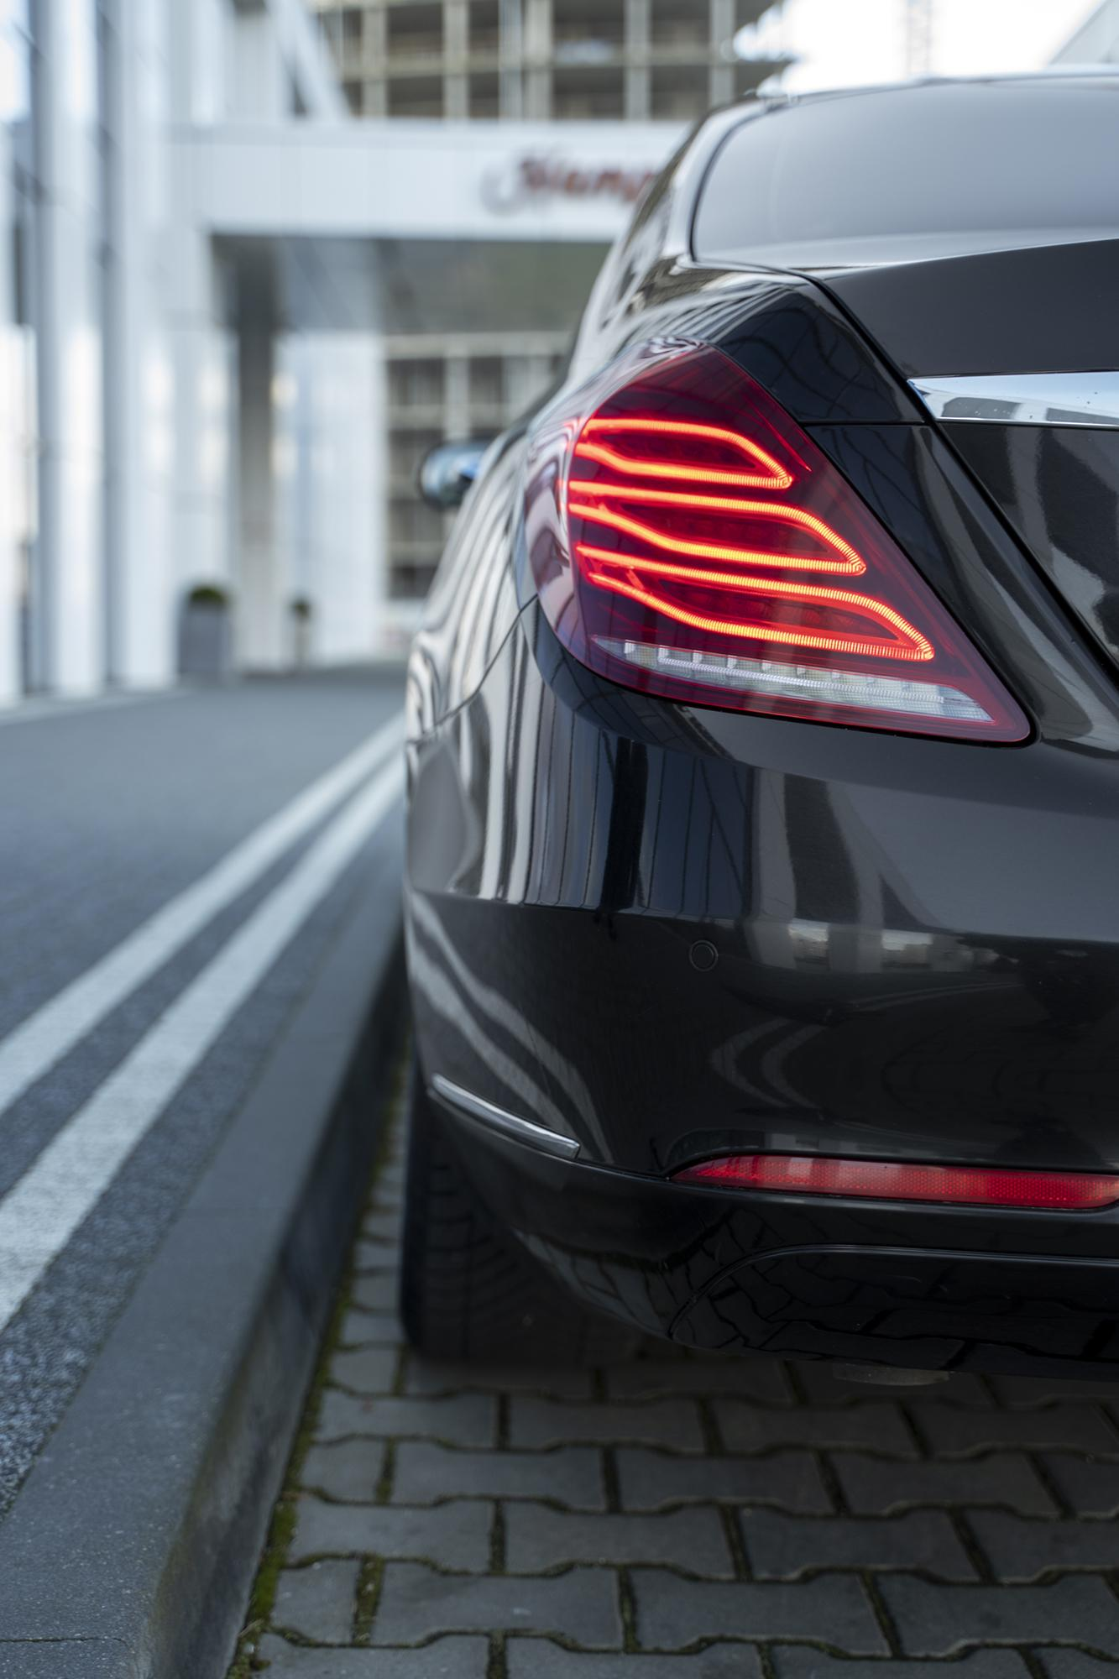
Data Exploration
&
Feature Engineering
9

Slide 10
14 Additional Data Sources Were Used Used for Modeling to Ensure a More Robust Data Set
From Nissan
Externally Sourced
Edmunds
Inventory
Inflation
GDP
Customer Confidence Index
+
+
MSRP
Vehicle Spec Data
NCBS
OaO
Metal Price
Producer Price Index
Other
Index
Originally
used
Segment
Volume
Residual Value
Additional Data Sources
10

Slide 11
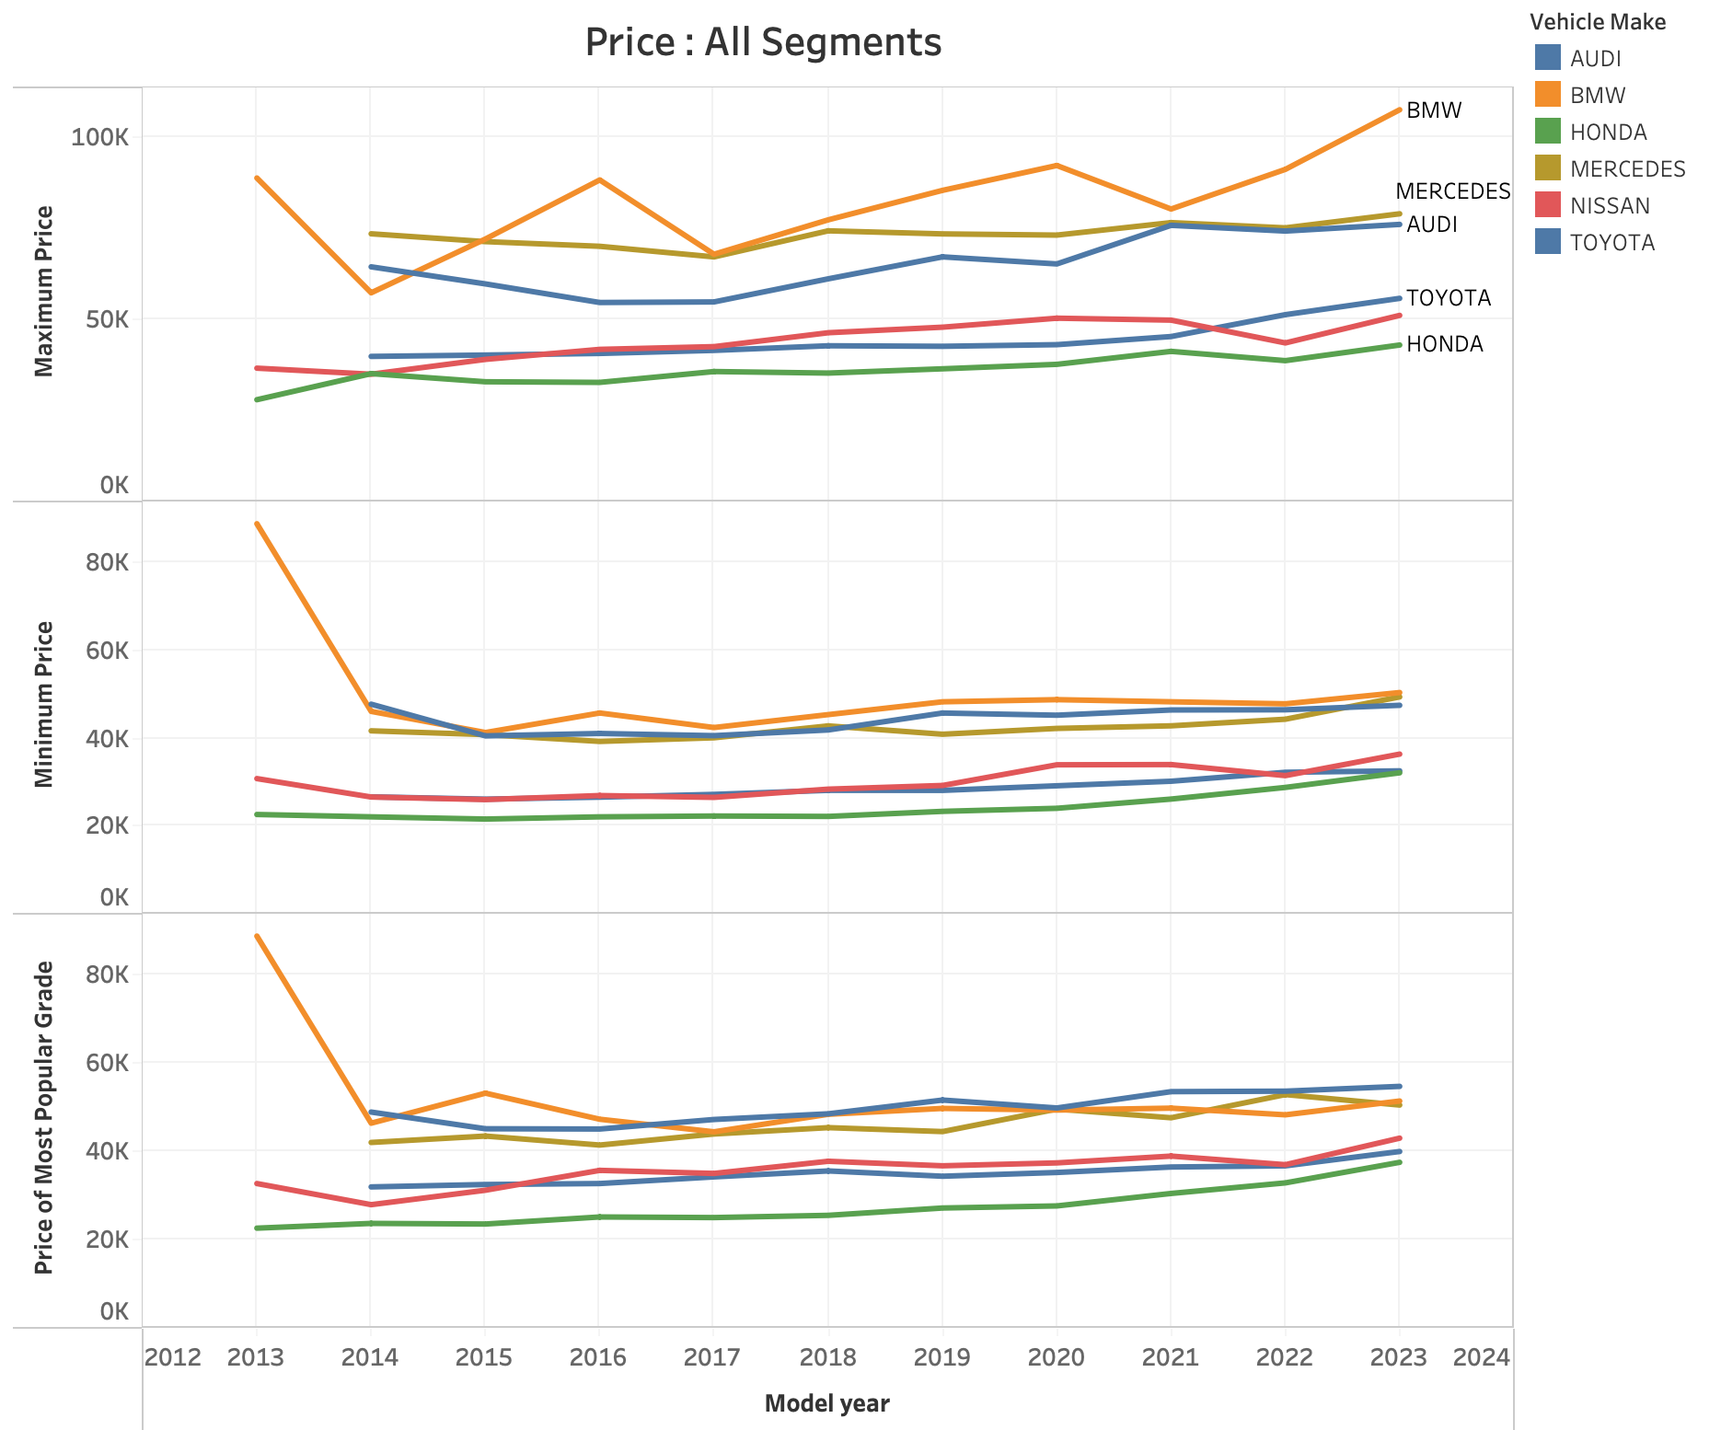
Nissan and Other Japanese Manufacturers Pass Less of Additional Manufacturing Costs to Customers
Japanese car manufacturers did not drastically raise prices in response to COVID or the chip shortage
German brands include additional costs to customers
Nissan should factor macroeconomic conditions into the pricing model
MSRP by Model Year
11

Slide 12
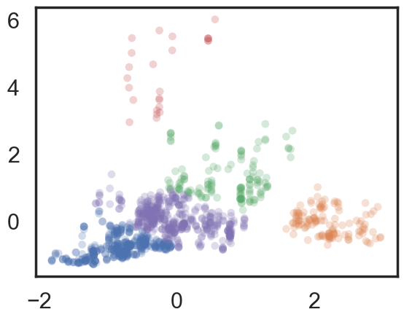

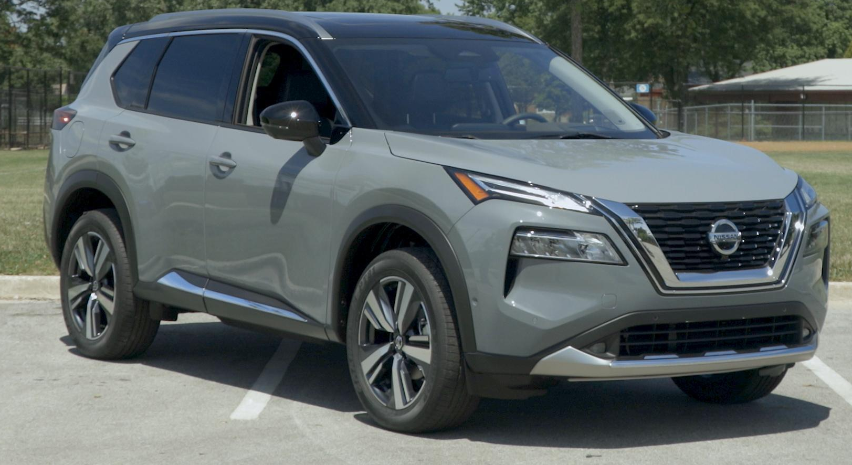
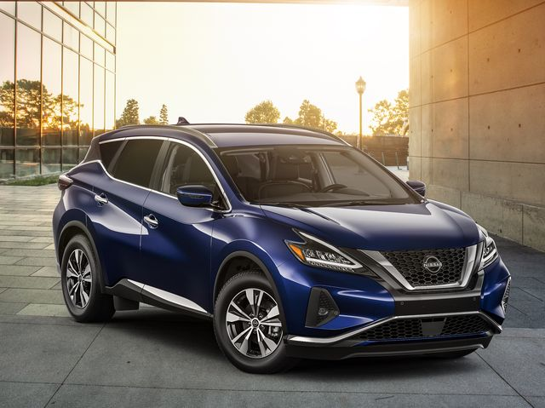
K-Means Clustering was Used to Create Three Clusters Based on MSRP and Vehicle Body Size
K-Means Cluster
Outliers
High Price
Weighted MSRP
Mid Price
Large size
Titan
Low price
Small size
Mid Price
Mid size
Rogue
Murano
Body size (Width x Length)
12

Slide 13

Modeling
&
Results
13
12

Slide 14
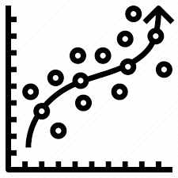


Modeling was Completed in Three Phases
1. Feature Selection
2. Predictive Analysis: ML
3.Descriptive Analysis: GLM
14

Slide 15
Feature Selection was Needed to Select the Most Important out of 1,105 Potential Features
Step 1: Generalized Linear Model
Model coefficient’s p-value < 0.05
Step 2: Statistical Testing
Coefficient’s p-value < 0.05
Abs(correlation) > 0.05 for numerical features
Step 3: Machine Learning Models
Random Forest, XGBoost, Adaboost
Model features importance (Recursive Feature Elimination)
15

Slide 16
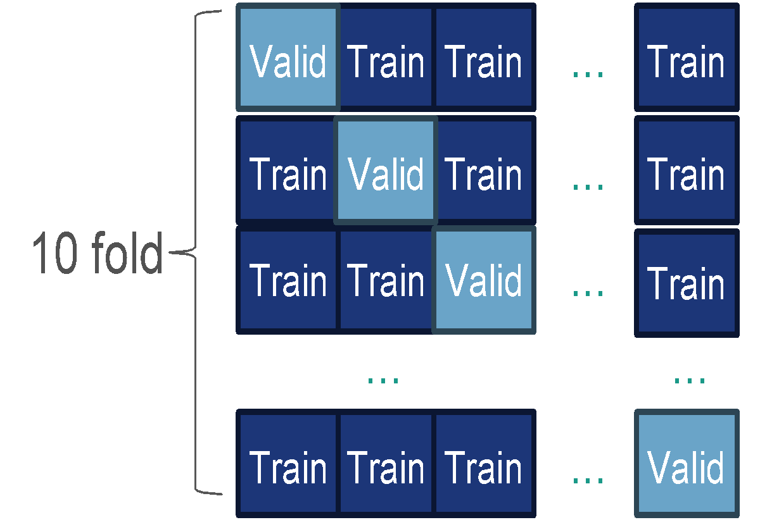
Machine Learning & Generalized Linear Model Workflow
Data Split
Model selection
Validation
Machine Learning Models
Tree based models
CV & Randomized search
Random Forest
XG Boost
AdaBoost
Train
Valid
Test
Best Model & Hyperparameters
Data
30% Test
70% Train
Test
GLM
Gamma distribution + Log link
Forward feature selection
Train
Step AIC: best fitting (Lowest AIC) features
16

Slide 17



Low Price Small Size Cluster: XGBoost had the Lowest Prediction Error and there are Cost Saving Features are the Most Important Factors for MSRP
Top 10 Important Features
Unit impact* on MSRP
Model Accuracy
Important
Manual Air conditioning | 0.96
Secondary Ventilation Controls | 0.99
LED High beam | 1.02
Pedestrian / cyclist avoidance | 1.02
FR Passenger seat heated | 1.03
Start Stop system | 1.02
Plastic Steering | 0.97
Overtaking sensor | 1.02
Subwoofer | 1.04
Navigational systems | 1.02
GLM
Train R2 | 0.99 | 0.93 | 0.97 | -
CV R2 | 0.99 | 0.92 | 0.95 | -
Test R2 | 0.97 | 0.86 | 0.90 | 0.95
Test RMSE | 868 | 1779 | 1611 | 1198
*Unit Impact example:
Manual Air conditioning is included → MSRP x 0.96
17

Slide 18

Mid Price Mid Size Cluster: XGBoost had the Lowest Prediction Error and Utility Features are Most Important Factors for MSRP
Top10 Important Features
Unit impact* on MSRP
Model Accuracy
Important
PG side door mirror tilt for reverse | 1.04
Door mirror auto dimming | 1.02
FR/PG seat lumbar electric | 1.02
Maximum torque Nm(Numerical) | 1.001
Rain sensor | 1.01
Secondary ventilation controls | 1.02
Previous MY MSRP (Numerical) | 1.00001
Screen size inch (Numerical) | 1.004
Plastic Steering | 0.97
Wheel rim diameter inch(Numerical) | 1.02
GLM
Train R2 | 0.99 | 0.94 | 0.99 | -
CV R2 | 0.99 | 0.93 | 0.97 | -
Test R2 | 0.98 | 0.91 | 0.95 | 0.96
Test RMSE | 1814 | 3595 | 2624 | 2538
*Unit Impact example:
Max torque +5Nm → MSRP x ${(1.001)}^{5}$
18

Slide 19
Mid Price Large Size Cluster: XGBoost had the lowest prediction error and Driveability Features are the Most Important Factors for MSRP
Top10 Important Features
Unit impact* on MSRP
Model Accuracy
Important
Overtaking sensor | 1.03
Subwoofer | 1.09
LED lowbeam | 1.06
Compressor turbo | 1.09
Crew cab | 1.07
Driven wheels: Rear | 0.90
Privacy glass | 1.04
Regular cab | 0.93
Plastic steering | 0.98
Glass roof | 1.07
GLM
Train R2 | 0.99 | 0.92 | 0.97 | -
CV R2 | 0.99 | 0.91 | 0.95 | -
Test R2 | 0.99 | 0.87 | 0.94 | 0.98
Test RMSE | 805 | 2680 | 1874 | 1355
*Unit Impact example:
Driven wheels: Rear→ MSRP x 0.9
19

Slide 20
Prediction Errors Decreased and Model Accuracy Increased When Using the XGBoost Model Across All Three Clusters
RMSE Using Nissan’s Traditional Approach
vs
RMSE Using XGBoost
(Proposed Method)
Low price
Small size
1207
825
32% improvement
Mid Price
Mid size
4883
1316
73% improvement
Mid Price
Large size
1569
929
41% improvement
20

Slide 21
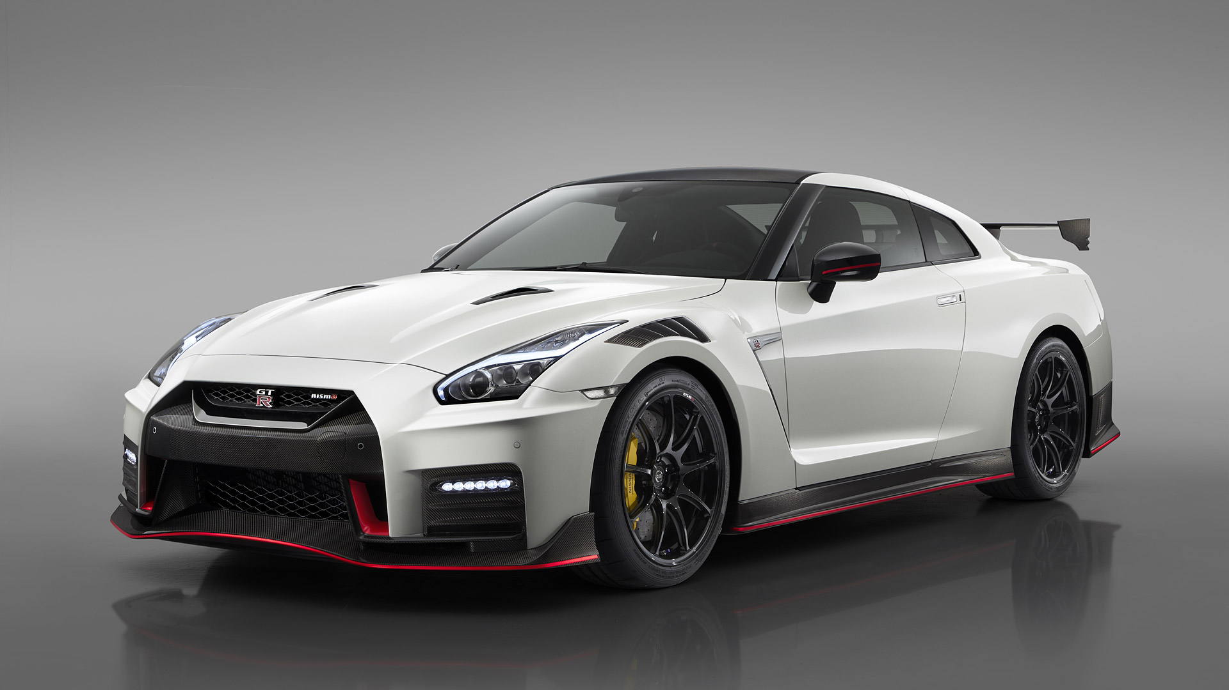
Limitations of Analysis
&
Next Steps
21
21

Slide 22



Limitations and Future Considerations
Need to consider relationship between Volume & MSRP
Brand perception efforts may need to be revisited
Data needs to be updated frequently
22

Slide 23
~$168 Million USD
Estimated additional revenue could have been generate over the past 5 years if our model was used to set MSRP
23

Slide 24
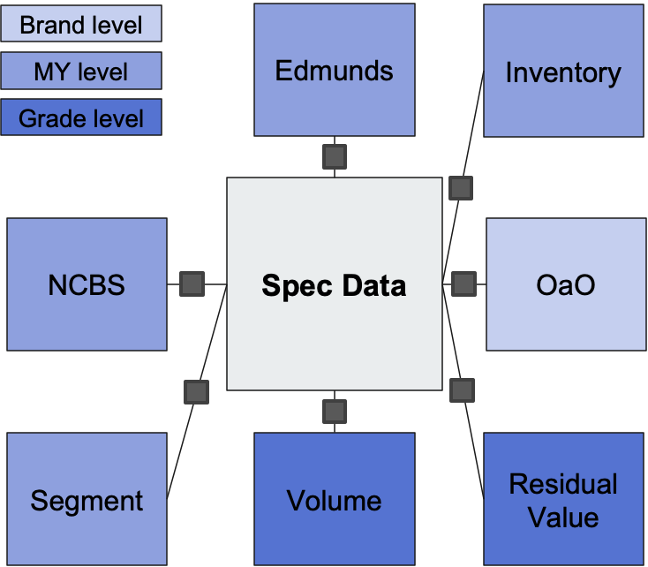
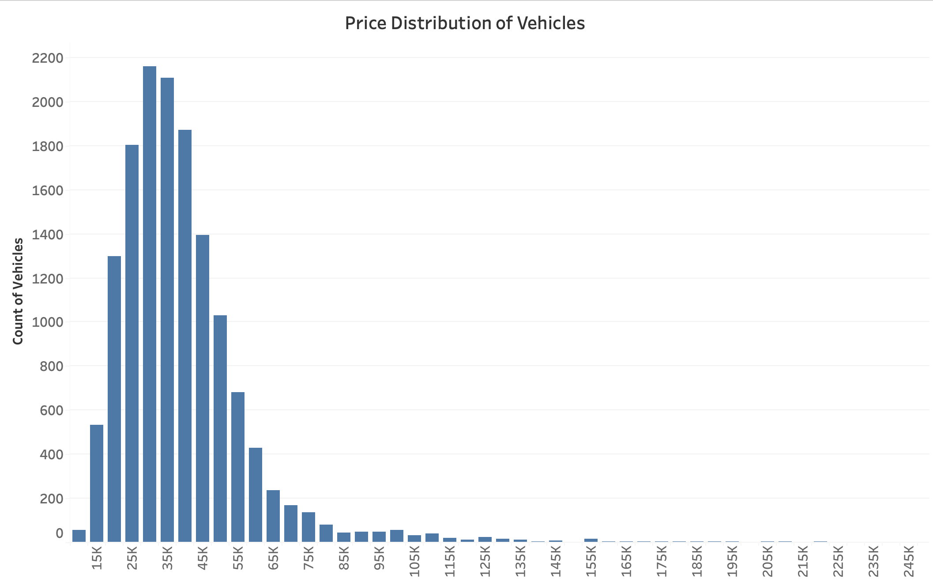
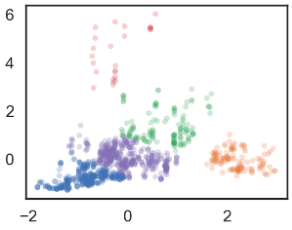

Next Steps: Deploy a Pipeline to Automate Analysis and Save Over 50+ Hours of Work
Data Combination
Exploratory Data Analysis
Feature Engineering
Modeling
Evaluation & Recommendations
24

Slide 25
Thank You!
Q & A
25

Slide 26
Appendix
26

Slide 27
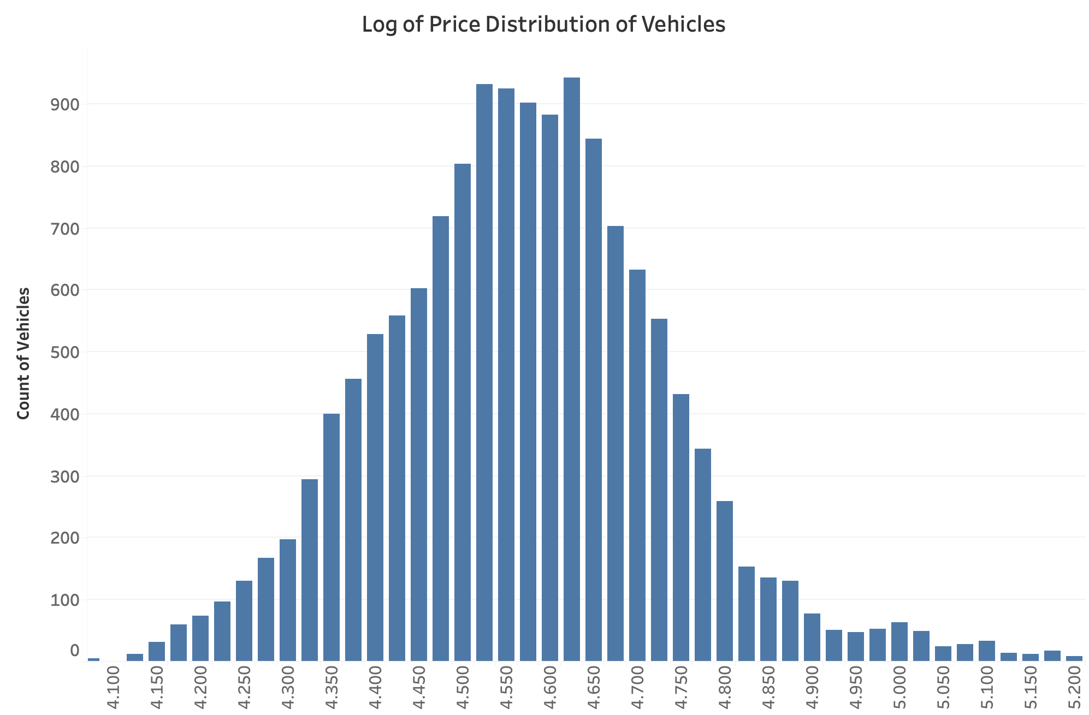
Log of Price Had to be Taken to Normalize the Distribution
27

Slide 28
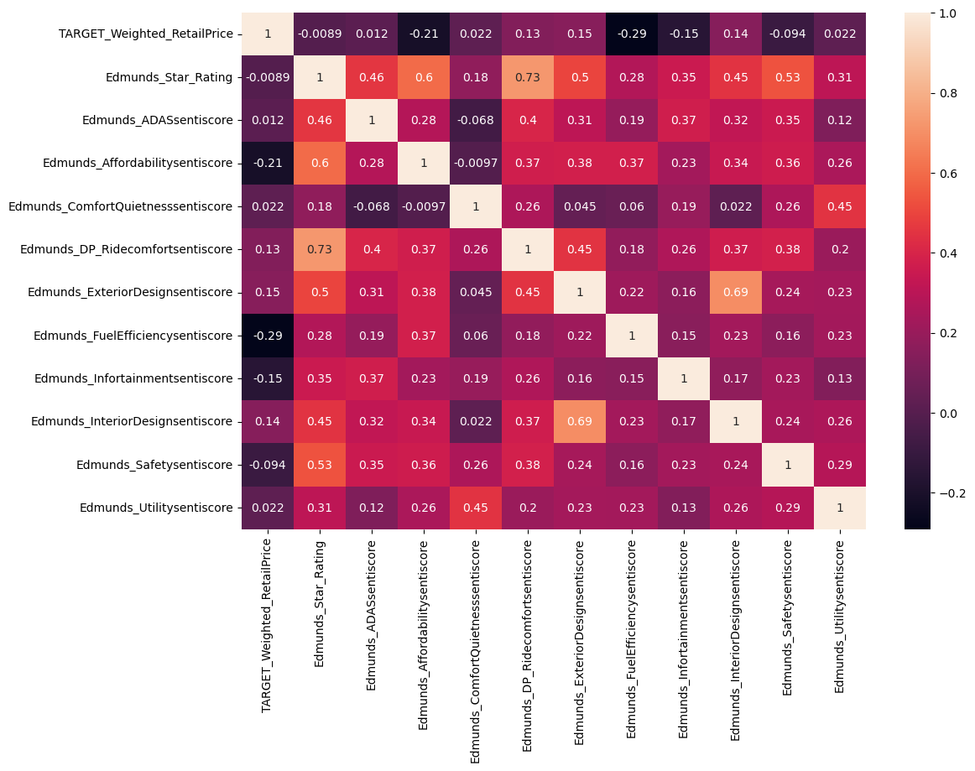
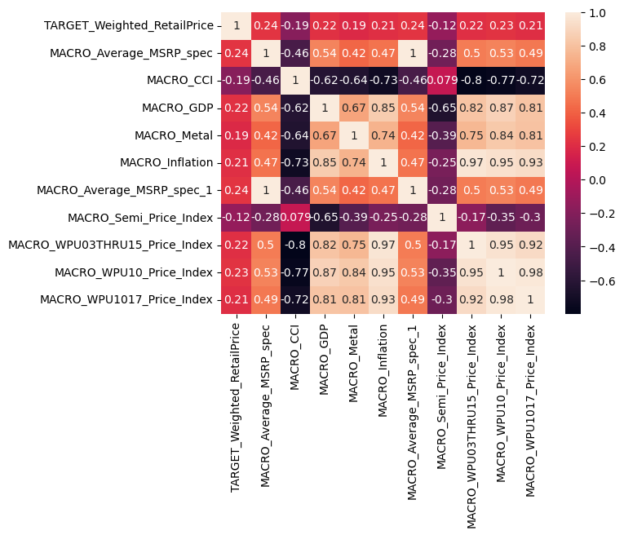
Correlation between MSRP and Various Factors Were Taken to Check for Feature Importance
Edmunds.com Reviews
Macroeconomic Factors
28

Slide 29

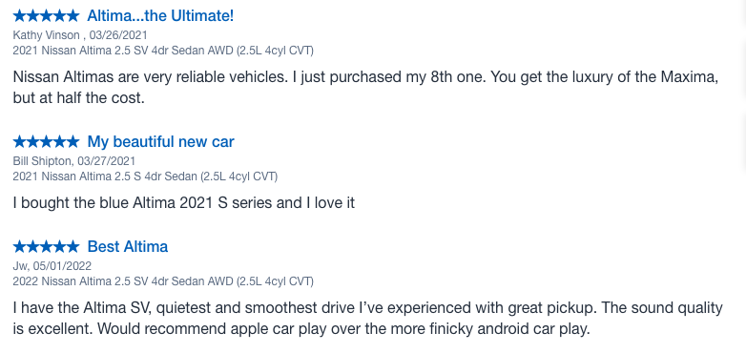
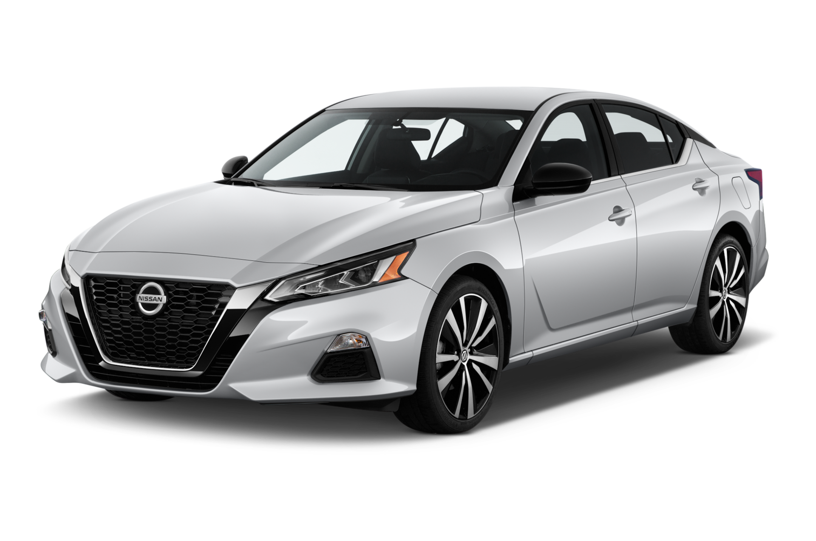
Log of Price Had to be Taken to Normalize the Distribution
NLP
Text Data from
Edmunds.com
Topic
X
Sentiment
Model Year 2023 Nissan Altima
Exterior
0.8
Interior
0.7
…
…
Sentence detectors/
Transformers
(BERT)
Performance
0.8
29

Slide 30
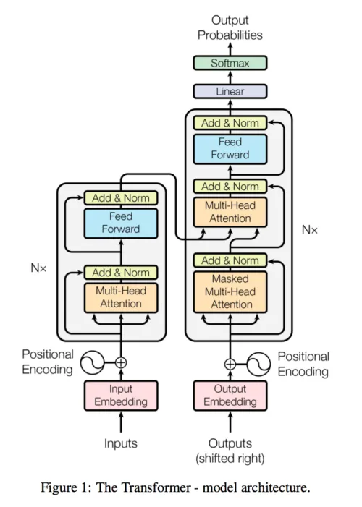

Transformers Were Used for mMaking Edmunds.com Review Data Usable
Transformer is a state-of-art deep learning model for NLP.
High speed / High Accuracy / and well generalized.
5. Neural Network
3. Neural Network
4. Understand important word for the task
2. Get the relationship score (Self attention) between words in the text
1. Words & positions are embedded(Vector with lower dimensions)
Source: http://jalammar.github.io/illustrated-transformer/
https://nlpillustration.tech/?p=2171
30

Slide 31
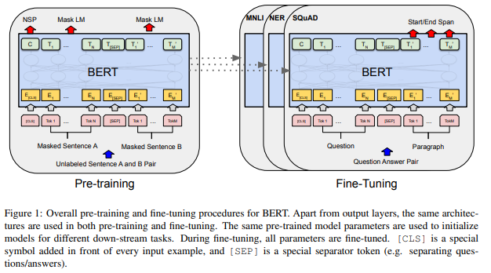
Transformers Were Used for mMaking Edmunds.com Review Data Usable
BERT is a technology using Transformer.
Pre-Trained model is available, and by preparing the fine-tuning training dataset, many kinds of NLP problems can be solved.
Pre-trained model
is provided on Hugging face
31

Slide 32
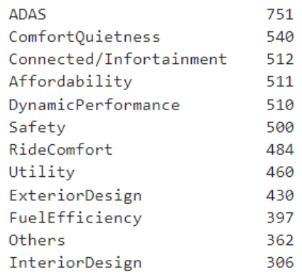
Feature engineering with NLP: Training dataset
Prepared the model sentences by human-eyes, trained the model with this data.
Prepared sentences number
sentence | Category | Sentiment
autonomous driving technology is great. | ADAS | positive
spacious interior with balanced, | ComfortQuietness | positive
The forester handles the roads well as long as it has good tires | DynamicPerformance | positive
it was a bad looking vehicle, | ExteriorDesign | negative
32

Slide 33
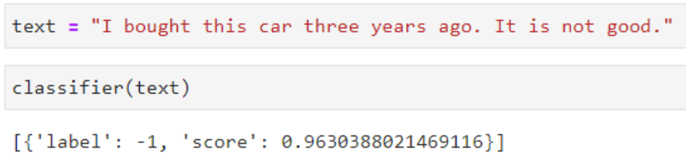
Precision / Recall / F1 for NLP Model
 | Accuracy | Precision | Recall
ADAS | 93% | 91% | 96%
Affordability | 92% | 95% | 96%
Comfort / Quietness | 95% | 95% | 96%
Infortainment | 95% | 96% | 94%
Exterior Design | 90% | 90% | 91%
Interior Design | 93% | 90% | 95%
Fuel efficiency | 98% | 100% | 97%
Safety | 96% | 97% | 95%
Utility | 88% | 86% | 90%
DP Ride comfort | 96% | 96% | 97%
 | Accuracy | Precision | Recall
Sentiment | 99% | 99% | 99%
33

Slide 34

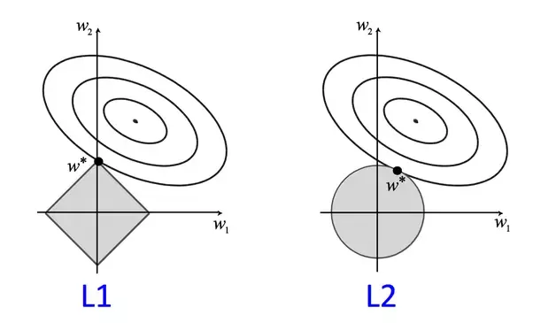
Why XGBoost Performed the Best
Gradient Boosting:
XGBoost is a type of Gradient Boosting algorithm that sequentially adds decision trees while focusing on correcting the errors of previous trees. This allows it to efficiently reduce model bias
Regularization:
XGBoost includes a regularization term in the loss function to prevent overfitting. This helps restrain the model from overly fitting the training data and improves generalization performance.
34

Slide 35
GLM Supplemental Explanation
Gamma dist + Log link
Forward feature selection
MSRP ~ 1 + torque → AIC: 56,183
MSRP ~ 1 + torque + cruise control → AIC: 55,020
MSRP ~ 1 + torque + cruise control + .... → AIC: xxx
Step AIC: best fitting (Lowest AIC) features
The Akaike Information Criterion (AIC) = -2ln(L) + 2k
AIC considers the model’s goodness of fit and its complexity.
The number of independent variables used to construct the model (k), and the maximum likelihood estimate of the model. (L)
35

Slide 36
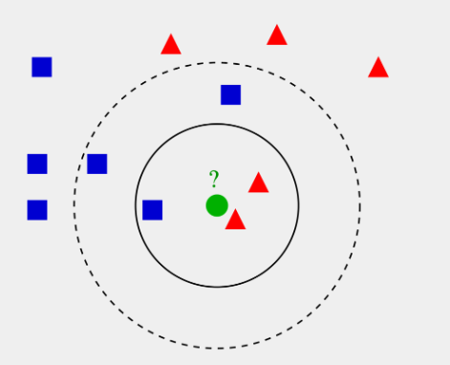

Missing Values in the Data were Imputed Depending on the Context
k-nn imputer for randomly missing values
Took the average of the same generation’s values for evaluation and residual values
36

Slide 37
K-Means Category and Vehicle Segment Relationship
Segment Used by Nissan | Category determined by K-Mean Cluster
Compact | LowPrice_Smallsize
Compact LCV Van | LowPrice_Smallsize
Compact SUV | LowPrice_Smallsize
Entry | LowPrice_Smallsize
Entry SUV | LowPrice_Smallsize
Lower Mid SUV | LowPrice_Smallsize
Lower Midsize | LowPrice_Smallsize
D Coupe | MidPrice_Midsize
Large SUV | MidPrice_Midsize
Mid Luxury | MidPrice_Midsize
Midsize Pickup | MidPrice_Midsize
Midsize SUV | MidPrice_Midsize
Near Luxury | MidPrice_Midsize
Upper Midsize | MidPrice_Midsize
Full-size Pickup | MidPrice_Largesize
Full-size LCV Van | MidPrice_Largesize
37

Slide 38
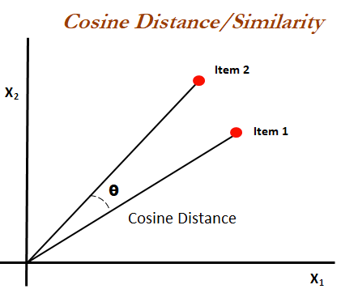


Process to Combine Data Sources into a Single Table
Matching two table’s keys
using cosine similarities
Manually confirmed
the matching accuracy
Next step:
Use Large Language Model
to match the keys
38

Slide 39
A Mixed-Effect Model was Built but Failed to Outperform XGBoost
MSRP ~ features + (1|PROFILE_Make) + (1|CATEGORY)
The model accounts for roughly 91% of the MSRP variance, maintaining an average prediction error of $4420.87.
The model was executed with 112 features inclusive of two grouping (random effect) variables.
The mixed-effects model's predictive capability is found to be inferior compared to the XGBoost model for vehicle cluster categories.
Mixed Effects
Train R2 | 0.99 | 0.90
CV R2 | 0.99 | 0.90
Test R2 | 0.99 | 0.90
Test RMSE | 1162 | 6349
39

Slide 40
Other factors impact Low Price Small Size Cluster
Features
Unit impact* on MSRP
Previous years’ MSRP weighted by Volume | 1.0002
Macro indicator: Inflation | 1.004
Residual Value: 60 months(Percentage from original value) | 1.005
Edmunds Exterior design score (Max 1: Min -1) | 1.10
*Unit Impact example:
Manual Air conditioning is included → MSRP x 0.958
18
Notes:
KRISPY Score: 24
K: 5
R: 4
I: 4
S: 3
P: 5
Y: 3

Slide 41
Other factors impact Mid Price Mid size
Features
Unit impact* on MSRP
Previous years’ MSRP weighted by Volume | 1.000008
Macro indicator: Consumer Confidence Index | 0.997
NCBS Overall brand image | 1.022
NCBS Environmental Friendliness | 1.007
*Unit Impact example:
Manual Air conditioning is included → MSRP x 0.958
20
Notes:
KRISPY Score: 24
K: 5
R: 4
I: 4
S: 3
P: 5
Y: 3

Slide 42
Other factors impact Mid Price Large size
Features
Unit impact* on MSRP
Previous years’ MSRP weighted by Volume | 1.000006
Macro indicator: Inflation | 1.0042
NCBS Exterior styling | 1.0185
Edmunds Exterior design score (Max 1: Min -1) | 1.2600
PROFILE_Make_FORD | 0.9818
*Unit Impact example:
Manual Air conditioning is included → MSRP x 0.958
22
Notes:
KRISPY Score: 24
K: 5
R: 4
I: 4
S: 3
P: 5
Y: 3

Slide 43
Revenue Opportunity Calculation Logic
Case 1: Volume Opportunity
Case 2: Revenue Opportunity
Actual
Suggested
by model
Volume opportunity
Model error (RMSE)
Adjusted Prediction
Model error (RMSE)
Adjusted Prediction
Suggested
by model
Revenue opportunity
Actual
Case 3: Not significant -> Not included in revenue opportunity
Model error (RMSE)
Suggested
by model
Actual
Model error (RMSE)
OR
Actual
Suggested
by model
40

